Slide 1
Splitsmart Planning Presentation
Group 2

Slide 2
AGENDA
Introduction
Project Estimates
Risk Management
Project Schedule
Staff Organization
Tracking and Control Mechanisms
Summary

Slide 3
INTRODUCTION
SplitSmart aims to provide users with a comprehensive expense management solution. SplitSmart will allow users to create and manage user accounts, create and track expenses, manage groups, track balances, record payments, and generate reports.
Software overview
Functionality
Major Software Functions
Performance/Behavior Issues
Management Constraints
Technical Constraints

Slide 4
Project Estimates

Slide 5
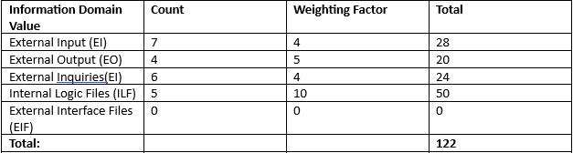
Estimation Using FPA
Function Points
Value Adjustment Factor [0.65 + 0.01 * Σ Fi] = [0.65 + 0.01 * 38] = 1.03
FP = T * (0.65 + 0.01 x Σ Fi) = 122 * 1.03 = 125.66 ≈ 126
Cost per FP = $8000 / 15 = $533.33 per FP
Total Estimated Project Cost: $533.33 x 126 = $67,200.
Total Estimated Effort: 126 / 15 = 8.4 person-months
Estimated Duration: 8.4 / 4 = 2.1 months

Slide 6
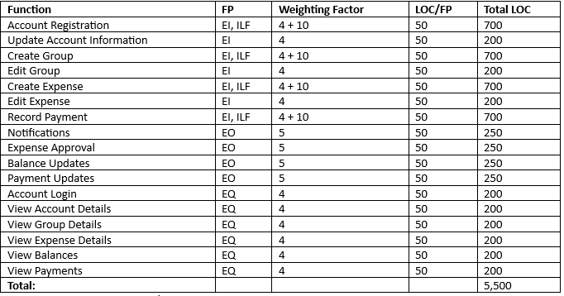
Loc-Based Estimation
LOC
Total Estimated Project Cost : $4 x 5500 = $22,000
Total Estimated Effort: 5500 / 2000 = 2.75 person-months
Estimated Duration: 2.75 / 4 = 0.69 months
Average Productivity: 2000 LOC/pm
Cost per LOC = $8000 / 2000 = $4 per LOCA

Slide 7
Reconciled Estimate
Final Estimated Project Cost: (67,200 + 22,000) / 2 = $44,600
Final Estimated Effort: (8.4 + 2.75) / 2 = 5.58 person-months

Slide 8
Risk Management

Slide 9
Risk Management
Risk Table
Risk ID | Risk | Probability | Impact | RIS Pointer
PO-1 | Requirements change during development | 35% | 2 | RIS 1
PO-2 | Technical Limitations or challenges | 35% | 2 | RIS 2
PO-3 | Insufficient resource availability | 15% | 2 | RIS 3
PO-4 | Poor software quality or performance | 15% | 2 | RIS 4
PO-5 | Project schedule delays | 45% | 3 | RIS 5
PO-6 | Inaccurate project estimates | 10% | 1 | RIS 6
PO-7 | Ineffective Project Communication | 15% | 3 | RIS 7

Slide 10
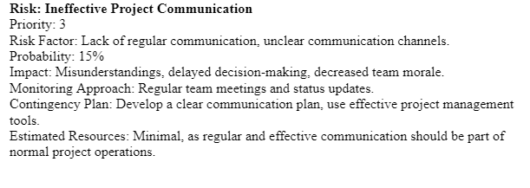
Risk Management
Risk Mitigation, Monitoring, Management:
Risk Identification
Risk Analysis
Risk Mitigation
Risk Monitoring
Risk Management

Slide 11
Project Schedule

Slide 12
Project schedule
Project Task Set
Planning
Time and Resource Requirement Estimates
Overview of features, plans for implementation
Scheduling
Requirements Analysis
Document Requirements
Use Cases
Design
Analysis of plan
Diagramming Process
Implementation
Implement features
Test features
Deployment
Maintenance

Slide 13
Project schedule
Functional Decomposition
User Management
Expense creation, editing, deletion, approval
Group Management
Group creation, editing, deletion
Expense Management
Expense creation, editing, deletion, approval
Balance Tracking
Balance calculation, balance updating
Payment Tracking
Payment record creation, editing, deletion
Reporting
Standard and custom reports, report exportation
Notification System
Notification creation and delivery, notification settings

Slide 14
Staff organization

Slide 15
Team structure
Project Manager
Lead Developer
Front-End Developer(s)
Back-End Developer(s)
Reporting and Communication
Weekly status meetings
Progress reporting
Change Management
Issue Tracking
Risk Management

Slide 16
Tracking and Control Mechanisms

Slide 17
Quality Assurance and Control
Requirement Review
Code Review
Testing
Bug Tracking and Resolution
Deployment and Maintenance
Quality Control

Slide 18
Change Management and control
Change Request Management
Change Control Board
Configuration Identification
Version Control
Configuration Control
Configuration Status Accounting

Slide 19
SUMMARY
The project planning involved several phases from requirement analysis, system design, cost and time estimations, development, testing, deployment, and maintenance. Project risks have been identified and strategies for mitigation, monitoring, and management are in place. Our team is well-equipped and ready to build an efficient, user-friendly solution that simplifies expense sharing.

Slide 20
THANK YOU

